Slide 1
Paper Quality Enhancement And Model Prediction Using Machine Learning Techniques Domain: ML
Presented by
Name : Pranjali S
USN : 1CR19IS107
Under the Guidance of
Dr. Srividya R
Associate Professor,
Dept of Information Science and Engineering.

Slide 2
AGENDA
Abstract
Introduction
Proposed methodology and implementation
Results and discussion
Conclusion
References

Slide 3
ABSTRACT
A machine learning approach demonstrated in the proposed study predicts the parameters involved in paper quality enhancement in real time.
The training and testing data sets were obtained to develop several machine learning models through several data from the parameters of the paper-making process.
The inputs considered were moisture, weight, and grammage.
Modeling was carried out based on model interpretation and cross-validation results, showing that the developed model could be a more useful tool in predicting the performance of the steam pressure and input parameters in the paper-making process.
Machine learning is also used to predict the efficiency of steam pressure reduction.

Slide 4
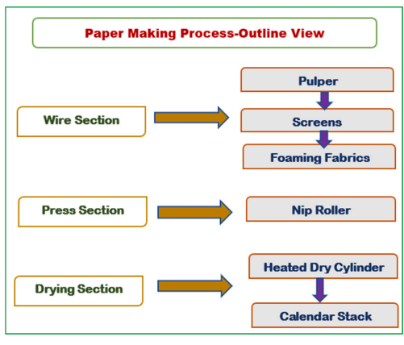
INTRODUCTION
Paper manufacturing is divided into eight steps that are sequentially performed as shown in figure below.
The paper-making machine has a width of 10–15 feet and a length that varies from half a football field to a full football field, which is 100 yards. The wet end and the dry end make up the main components.

Slide 5
INTRODUCTION
An endless belt of plastic or wire screen moves continuously.
Step 1: The pulp mixture and water are spread across a forming fabric which resembles a large mesh screen on the front end, or wet end, of the paper machine.
Step 2: At this point, the pulp is 99.5 % water to 0.5 % pulp. Gravity, suction, and a mechanized vibration of the screen quickly begin to remove 20% of the water, much of which is re-used at the mill. Strict environmental guidelines are followed for the volume and quality.
Step 3: The next step on the wet end is the press section where even more water is removed. With the water still at 60%, the mix gets squeezed through large cloth wrapped cylinders called wet felts. It’s at this point in the paper making process that the product starts to get its smoothness and thickness.
Step 4: Once through the felts, the paper enters the dryer section. Here, it passes through steam heated dryers that leave the product with a moisture content of 2-6%.

Slide 6
INTRODUCTION
Step 5: The next stop is the size press; at this point, a starch solution is applied to both sides of the sheet. If you have ever used starch while ironing your clothes, you can get an idea of what is happening to the paper. The starch solution enhances its ability to resist water and ink penetration during the offset printing process. This step of the paper making process also gives the paper the ability to receive toners and liquid inks used in various types of digital printing.
Step 6: As it passes through this process, big, heavy cylinders called the calendar stack await the roll that is forming. These cylinders apply pressure to the sheet to form the desired smoothness and caliper of the paper. The pressure on the calendar stack can be adjusted. More pressure yields smoother paper with less thickness.
Step 7: At the end of the machine, the paper is wound on a large reel called the winder. As the reel of paper goes to the winder, it is slit into manageable size rolls. There are two basic type of roll formats; one is a roll that is sized for a web printing press for sheet fed machines and the second format converts rolls to be used in a sheeting application to be cut and packed into cartons. The winder offers the ability to customize sheeter roll sizes to maximize the efficiency and limit waste.
Step 8: Each finished roll, carton, or skid is stamped with a run number. We often refer to the run number as the birth certificate of the product. The run number displays the date, time, paper machine and which part of the large reel the paper came from. This information allows mill personnel to review this information to troubleshoot any quality issues that might happen on a printing press.
A full winder reel’s worth of paper weighs 30 tons, or a truck and a half of paper. That 60,000 lbs. took about 45 minutes to make from the wet end to the winder.

Slide 7
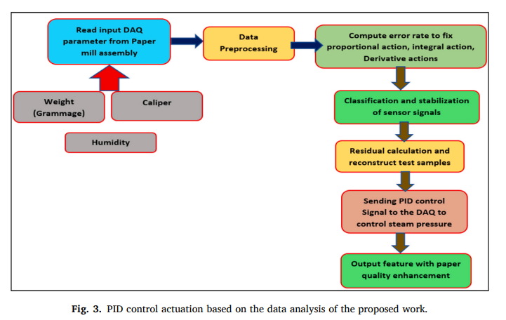
METHODOLOGY
In the present work, the development of paper quality enhancement using machine learning techniques is done based on different algorithms such as linear regression, decision tree, K-Nearest Neighbor, and Support vector Regressor.
The variables used are moisture, caliper, grammage, and output is controlling of steam pressure.
These three input variables play a crucial role in the reduction of steam pressure output for the paper industry.
Hence, these are considered as the key performance indicators as shown in figure.

Slide 8
METHODOLGY
Machine learning techniques with different algorithms were investigated and the results were compared. In addition, model interpretation, cross-validation, and error calculation have been performed by comparing with the existing models.
Figure shows the proposed model of paper quality enhancement. The dataset for moisture, caliper and weight are imported and the sample values are displayed for verification.
The dataset is divided into training data and testing data and they are provided for performing linear regression, KNN, decision tree, and support vector regression.
The execution time is noted and the predicted values are found for calculating errors like mean squared error, mean absolute error, root mean squared error, and R squared score.
The error graph is plotted based on mean absolute error and the line plot graph is also plotted.
Finally, model interpretation is done to identify the best model to enhance the paper quality.

Slide 9
METHODOLOGY
In figure the dataset is imported and the sample values are displayed for verification.
The data is divided into training data (80%) and testing data (20%) and it is provided for performing linear regression, KNN, decision tree and support vector regression.
The execution time is noted and the predicted values are found for calculating errors like mean squared error, mean absolute error, root mean squared error and R squared score.
The error graph is plotted based on mean absolute error and the line plot graph is also obtained.
In the proposed work, both supervised machine learning algorithms are utilized for better result statistics of paper quality enhancement.
Hence, in the present work, under supervised machine learning both classification and regression category algorithm are applied and compared with each other for better enhancement.
So, under classification category Support Vector Regressor (SVR) is undertaken and compared with regression techniques like Linear Regression (LR), KNN and Decision Tree (DT).
Finally, model interpretation is also done and it is observed that KNN model is best suited for practice.

Slide 10
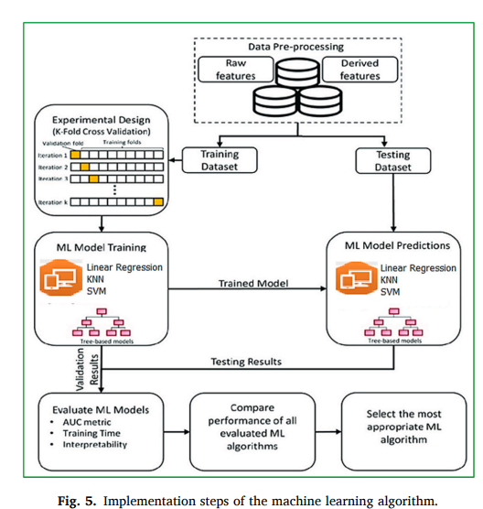
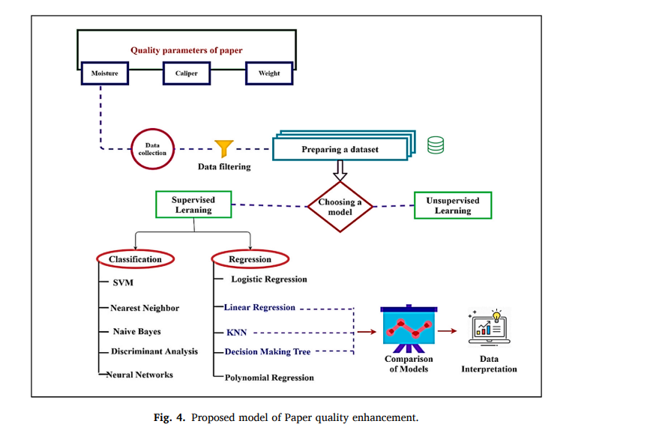
METHODOLOGY

Slide 11
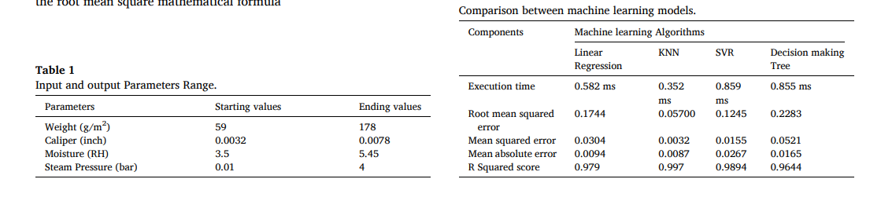
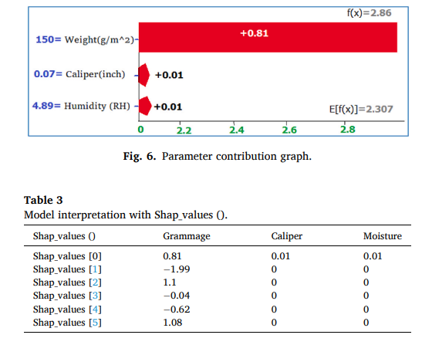
RESULTS AND DISCUSSIONS

Slide 12
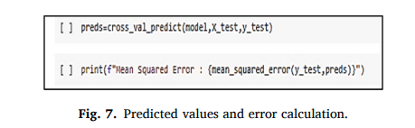
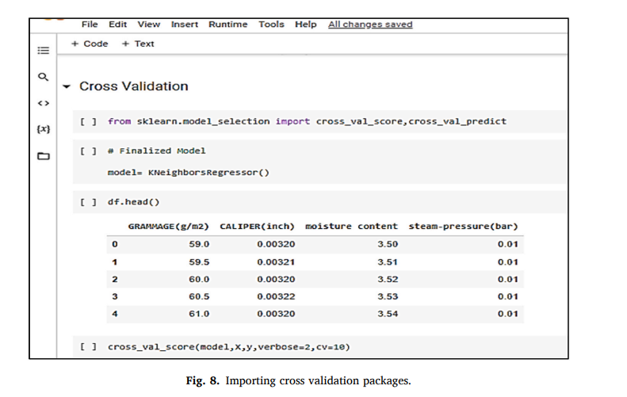
RESULTS AND DISCUSSIONS

Slide 13
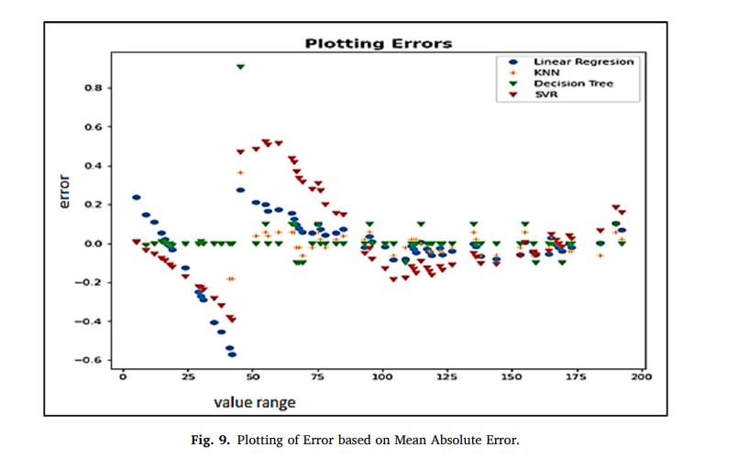
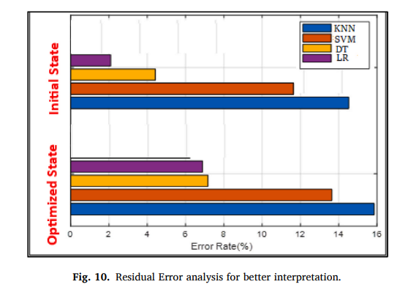
RESULTS AND DISCUSSIONS

Slide 14
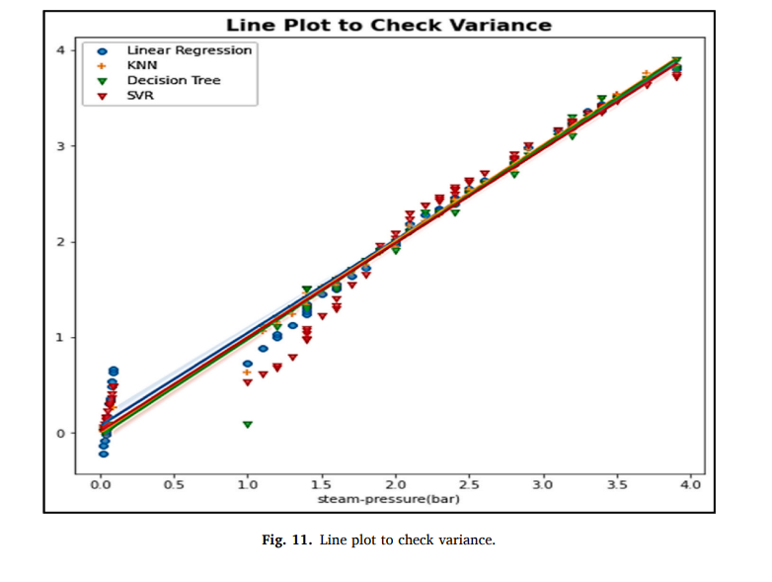
RESULTS AND DISCUSSIONS

Slide 15
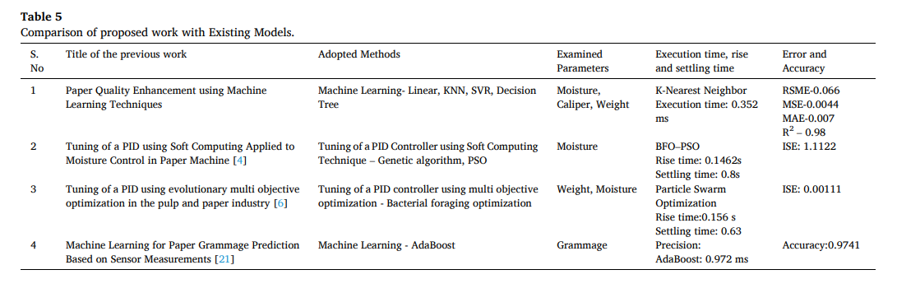
RESULTS AND DISCUSSIONS

Slide 16
CONCLUSION
This paper presents a machine learning model which meets the requirement of increasing the paper quality by adjusting the steam pressure applied to the paper at the drying section.
The model proposes the use of techniques which are Linear regression, KNN, Support vector regressor and Decision tree for moisture, caliper, grammage which decide the amount of steam to be used.
It also verifies the errors in different models which are mean squared error, root mean squared error, mean absolute error and R squared score.
The proposed method satisfies the necessities of reducing the usage of steam in the drying section.
Tried machine learning models show that the use of KNN model is best suited for practice that performs both regression and classification, it is easy for obtaining the values, has quick calculation time, has less error compared with linear regression, and has a high R squared score.
The proposed model indicates the root mean squared error which is 0.06, mean squared error which is 0.004, and mean absolute error as 0.0007 and R2 score as 0.996 which shows a better performance than the other methods.
From the analysis of the machine learning algorithms, it is found that the reduction in 0.5% of moisture in the drying section then results in reduction of 0.09% in steam pressure which is found in the cross validation.
This suggests that the efficiency of the system increases with 1.34% of energy recovery.

Slide 17
REFERENCES
V.D. Baloyi, L.D. Meyer, The development of a mining method selection model through a detailed assessment of multi-criteria decision methods, Res. Eng. 8 (2020), 100172.
M.A. Jaradeh, S.M. Suliman, Y. Al-Alawi, Improvement model for the proposal accuracy of security system design at industrial facilities, Res. Eng. 8 (2020), 100186.
O.M. Olabanji, K. Mpofu, Appraisal of conceptual designs: coalescing fuzzy analytic hierarchy process (F-AHP) and fuzzy grey relational analysis (F-GRA), Res. Eng. 9 (2021), 100194.
A.J. Adeyi, M.O. Durowoju, O. Adeyi, E.O. Oke, O.A. Olalere, A.D. Ogunsola, Momordica Augustisepala L. Stem fibre reinforced thermoplastic starch: mechanical property characterization and fuzzy logic artificial intelligent modelling, Res. Eng. 10 (2021), 100222.
D. Chakraborty, I. Awolusi, L. Gutierrez, An explainable machine learning model to predict and elucidate the compressive behavior of high-performance concrete, Res. Eng. 11 (2021), 100245.
S.H. Ghodbanan, R. Alizadeh, S. Shafiei, Thermodynamic and heat transfer evaluation of pocket drying section in the multi-cylinder dryers of the paper machine, Iran. J. Chem. Eng. 13 (Number 2) (2016) 57–70.

